Slide 1
Data Mining Primitives, Languages and System Architecture
CSE 634-Datamining Concepts and Techniques
Professor Anita Wasilewska
Presented By
Sushma Devendrappa - 105526184
Swathi Kothapalli - 105531380

Slide 2
Sources/References
Data Mining Concepts and Techniques –Jiawei Han and Micheline Kamber, 2003
Handbook of Data Mining and Discovery- Willi Klosgen and Jan M Zytkow, 2002
Lydia: A System for Large-Scale News Analysis- String Processing and Information Retrieval: 12th International Conference, SPRING 2005, Buenos Aires, Argentina, November 2-4 2005.
Information Retrieval: Data Structures and Algorithms - W. Frakes and R. Baeza-Yates, 1992
Geographical Information System - http://erg.usgs.gov/isb/pubs/gis_poster/

Slide 3
Content
Data mining primitives
Languages
System architecture
Application – Geographical information system (GIS)
Paper - Lydia: A System for Large-Scale News Analysis

Slide 4
Introduction
Motivation- need to extract useful information and knowledge from a large amount of data (data explosion problem)
Data Mining tools perform data analysis and may uncover important data patterns, contributing greatly to business strategies, knowledge bases, and scientific and medical research.

Slide 5
What is Data Mining???
Data mining refers to extracting or “mining” knowledge from large amounts of data. Also referred as Knowledge Discovery in Databases.
It is a process of discovering interesting knowledge from large amounts of data stored either in databases, data warehouses, or other information repositories.

Slide 6
Architecture of a typical data mining system
Graphical user interface
Pattern evaluation
Knowledge base
Data mining engine
Database or data warehouse server
Data cleansing
Data Integration
Filtering
Database
Data warehouse

Slide 7
Misconception: Data mining systems can autonomously dig out all of the valuable knowledge from a given large database, without human intervention.
If there was no user intervention then the system would uncover a large set of patterns that may even surpass the size of the database. Hence, user interference is required.
This user communication with the system is provided by using a set of data mining primitives.

Slide 8
Data Mining Primitives
Data mining primitives define a data mining task, which can be specified in the form of a data mining query.
Task Relevant Data
Kinds of knowledge to be mined
Background knowledge
Interestingness measure
Presentation and visualization of discovered patterns

Slide 9
Task relevant data
Data portion to be investigated.
Attributes of interest (relevant attributes) can be specified.
Initial data relation
Minable view

Slide 10
Example
If a data mining task is to study associations between items frequently purchased at AllElectronics by customers in Canada, the task relevant data can be specified by providing the following information:
  Name of the database or data warehouse to be used (e.g., AllElectronics_db)
  Names of the tables or data cubes containing relevant data (e.g., item, customer, purchases and items_sold)
  Conditions for selecting the relevant data (e.g., retrieve data pertaining to purchases made in Canada for the current year)
  The relevant attributes or dimensions (e.g., name and price from the item table and income and age from the customer table)

Slide 11
Kind of knowledge to be mined
It is important to specify the knowledge to be mined, as this determines the data mining function to be performed.
Kinds of knowledge include concept description, association, classification, prediction and clustering.
User can also provide pattern templates. Also called metapatterns or metarules or metaqueries.

Slide 12
Example
A user studying the buying habits of allelectronics customers may choose to mine association rules of the form:
P (X:customer,W) ^ Q (X,Y) => buys (X,Z)
Meta rules such as the following can be specified:
age (X, “30…..39”) ^ income (X, “40k….49K”) => buys (X, “VCR”)
[2.2%, 60%]
occupation (X, “student ”) ^ age (X, “20…..29”)=> buys (X, “computer”)
[1.4%, 70%]

Slide 13
Background knowledge
It is the information about the domain to be mined
Concept hierarchy: is a powerful form of background knowledge.
Four major types of concept hierarchies:
schema hierarchies
set-grouping hierarchies
operation-derived hierarchies
rule-based hierarchies

Slide 14
Concept hierarchies (1)
Defines a sequence of mappings from a set of low-level concepts to higher-level (more general) concepts.
Allows data to be mined at multiple levels of abstraction.
These allow users to view data from different perspectives, allowing further insight into the relationships.
Example (location)

Slide 15
Example
all
Level 0
Canada
USA
Level 1
British Columbia
Ontario
New York
Illinois
Level 2
Vancouver
Victoria
Toronto
Ottawa
New York
Buffalo
Chicago
Level 3

Slide 16
Concept hierarchies (2)
Rolling Up - Generalization of data
  Allows to view data at more meaningful and explicit abstractions.
  Makes it easier to understand
  Compresses the data
  Would require fewer input/output operations
Drilling Down - Specialization of data
  Concept values replaced by lower level concepts
There may be more than concept hierarchy for a given attribute or dimension based on different user viewpoints
Example:
Regional sales manager may prefer the previous concept hierarchy but marketing manager might prefer to see location with respect to linguistic lines in order to facilitate the distribution of commercial ads.

Slide 17
Schema hierarchies
Schema hierarchy is the total or partial order among attributes in the database schema.
May formally express existing semantic relationships between attributes.
Provides metadata information.
Example: location hierarchy
street < city < province/state < country

Slide 18
Set-grouping hierarchies
Organizes values for a given attribute into groups or sets or range of values.
Total or partial order can be defined among groups.
Used to refine or enrich schema-defined hierarchies.
Typically used for small sets of object relationships.
Example: Set-grouping hierarchy for age
{young, middle_aged, senior} all (age)
{20….29} young
{40….59} middle_aged
{60….89} senior

Slide 19
Operation-derived hierarchies
Operation-derived:
based on operations specified
operations may include
decoding of information-encoded strings
information extraction from complex data objects
data clustering
Example: URL or email address
xyz@cs.iitm.in gives login name < dept. < univ. < country

Slide 20
Rule-based hierarchies
Rule-based:
Occurs when either whole or portion of a concept hierarchy is defined as a set of rules and is evaluated dynamically based on current database data and rule definition
Example: Following rules are used to categorize items as low_profit, medium_profit and high_profit_margin.
low_profit_margin(X) <= price(X,P1)^cost(X,P2)^((P1-P2)<50)
medium_profit_margin(X) <= price(X,P1)^cost(X,P2)^((P1-P2)≥50)^((P1-P2)≤250)
high_profit_margin(X) <= price(X,P1)^cost(X,P2)^((P1-P2)>250)

Slide 21
Interestingness measure (1)
Used to confine the number of uninteresting patterns returned by the process.
Based on the structure of patterns and statistics underlying them.
Associate a threshold which can be controlled by the user.
patterns not meeting the threshold are not presented to the user.
Objective measures of pattern interestingness:
simplicity
certainty (confidence)
utility (support)
novelty

Slide 22
Interestingness measure (2)
Simplicity
a patterns interestingness is based on its overall simplicity for human comprehension.
Example: Rule length is a simplicity measure
Certainty (confidence)
Assesses the validity or trustworthiness of a pattern.
confidence is a certainty measure
confidence (A=>B) = # tuples containing both A and B # tuples containing A
A confidence of 85% for the rule buys(X, “computer”)=>buys(X,“software”) means that 85% of all customers who purchased a computer also bought software

Slide 23
Interestingness measure (3)
Utility (support)
usefulness of a pattern
support (A=>B) = # tuples containing both A and B total # of tuples
A support of 30% for the previous rule means that 30% of all customers in the computer department purchased both a computer and software.
Association rules that satisfy both the minimum confidence and support threshold are referred to as strong association rules.
Novelty
Patterns contributing new information to the given pattern set are called novel patterns (example: Data exception).
removing redundant patterns is a strategy for detecting novelty.

Slide 24
Presentation and visualization
For data mining to be effective, data mining systems should be able to display the discovered patterns in multiple forms, such as rules, tables, crosstabs (cross-tabulations), pie or bar charts, decision trees, cubes, or other visual representations.
User must be able to specify the forms of presentation to be used for displaying the discovered patterns.

Slide 25
Data mining query languages
Data mining language must be designed to facilitate flexible and effective knowledge discovery.
Having a query language for data mining may help standardize the development of platforms for data mining systems.
But designed a language is challenging because data mining covers a wide spectrum of tasks and each task has different requirement.
Hence, the design of a language requires deep understanding of the limitations and underlying mechanism of the various kinds of tasks.

Slide 26
Data mining query languages (2)
So…how would you design an efficient query language???
Based on the primitives discussed earlier.
DMQL allows mining of different kinds of knowledge from relational databases and data warehouses at multiple levels of abstraction.

Slide 27
DMQL
Adopts SQL-like syntax
Hence, can be easily integrated with relational query languages
Defined in BNF grammar
  [ ] represents 0 or one occurrence
  { } represents 0 or more occurrences
  Words in sans serif represent keywords

Slide 28
DMQL-Syntax for task-relevant data specification
Names of the relevant database or data warehouse, conditions and relevant attributes or dimensions must be specified
use database ‹database_name› or use data warehouse ‹data_warehouse_name›
from ‹relation(s)/cube(s)› [where condition]
in relevance to ‹attribute_or_dimension_list›
order by ‹order_list›
group by ‹grouping_list›
having ‹condition›

Slide 29
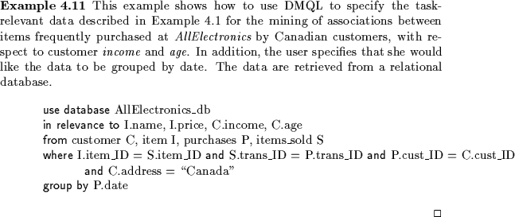
Example

Slide 30
Syntax for Kind of Knowledge to be Mined
Characterization :
‹Mine_Knowledge_Specification› ::=
mine characteristics [as ‹pattern_name›]
analyze ‹measure(s)›
Example:
mine characteristics as customerPurchasing analyze count%
Discrimination:
  ‹Mine_Knowledge_Specification› ::=
  mine comparison [as ‹ pattern_name›]
  for ‹target_class› where ‹target_condition›
  {versus ‹contrast_class_i where ‹contrast_condition_i›}
  analyze ‹measure(s)›
Example:
Mine comparison as purchaseGroups
    for bigspenders where avg(I.price) >= $100
    versus budgetspenders where avg(I.price) < $100
    analyze count

Slide 31
Syntax for Kind of Knowledge to be Mined (2)
Association:
‹Mine_Knowledge_Specification› ::=
mine associations [as ‹pattern_name›]
  [matching ‹metapattern›]
Example: mine associations as buyingHabits
    matching P(X: customer, W) ^ Q(X,Y) => buys (X,Z)
Classification:
    ‹Mine_Knowledge_Specification› ::=
    mine classification [as ‹pattern_name›]
    analyze ‹classifying_attribute_or_dimension›
Example: mine classification as classifyCustomerCreditRating
    analyze credit_rating

Slide 32
Syntax for concept hierarchy specification
More than one concept per attribute can be specified
Use hierarchy ‹hierarchy_name› for ‹attribute_or_dimension›
Examples:
Schema concept hierarchy (ordering is important)
    define hierarchy location_hierarchy on address as [street,city,province_or_state,country]
  Set-Grouping concept hierarchy
    define hierarchy age_hierarchy for age on customer as
  level1: {young, middle_aged, senior} < level0: all
  level2: {20, ..., 39} < level1: young
  level2: {40, ..., 59} < level1: middle_aged
  level2: {60, ..., 89} < level1: senior

Slide 33
Syntax for concept hierarchy specification (2)
  operation-derived concept hierarchy
    define hierarchy age_hierarchy for age on customer as
    {age_category(1), ..., age_category(5)} := cluster (default, age, 5) < all(age)
  rule-based concept hierarchy
    define hierarchy profit_margin_hierarchy on item as
    level_1: low_profit_margin < level_0: all
    if (price - cost)< $50
    level_1: medium-profit_margin < level_0: all
    if ((price - cost) > $50) and ((price - cost) <= $250))
    level_1: high_profit_margin < level_0: all
    if (price - cost) > $250

Slide 34
Syntax for interestingness measure specification
with [‹interest_measure_name›] threshold = ‹threshold_value›
Example:
with support threshold = 5%
with confidence threshold = 70%

Slide 35
Syntax for pattern presentation and visualization specification
display as ‹result_form›
The result form can be rules, tables, cubes, crosstabs, pie or bar charts, decision trees, curves or surfaces.
To facilitate interactive viewing at different concept levels or different angles, the following syntax is defined:
‹Multilevel_Manipulation› ::= roll up on ‹attribute_or_dimension›
| drill down on ‹attribute_or_dimension›
| add ‹attribute_or_dimension› | drop ‹attribute_or_dimension›

Slide 36
Architectures of Data Mining System
With popular and diverse application of data mining, it is expected that a good variety of data mining system will be designed and developed.
Comprehensive information processing and data analysis will be continuously and systematically surrounded by data warehouse and databases.
A critical question in design is whether we should integrate data mining systems with database systems.
This gives rise to four architecture:
- No coupling
- Loose Coupling
- Semi-tight Coupling
- Tight Coupling

Slide 37
Cont.
No Coupling: DM system will not utilize any functionality of a DB or DW system
Loose Coupling: DM system will use some facilities of DB and DW system
like storing the data in either of DB or DW systems and using these systems for
data retrieval
Semi-tight Coupling: Besides linking a DM system to a DB/DW systems, efficient implementation of a few DM primitives.
Tight Coupling: DM system is smoothly integrated with DB/DW systems. Each of these DM, DB/DW is treated as main functional component of information retrieval system.

Slide 38
Paper Discussion
Lydia: A System for Large-Scale News Analysis
Levon Lloyd, Dimitrios Kechagias,
Steven Skiena
Department of Computer Science
State University of New York at Stony Brook
Published in 12th International Conference
SPRING 2005, Buenos Aires, Argentina, November 2-4 2005

Slide 39
Abstract
This paper is on “Text Mining” system called Lydia.
Periodical publications represent a rich and recurrent source of knowledge on both current and historical events.
The Lydia project seeks to build a relational model of people, places, and things through natural language processing of news sources and the statistical analysis of entity frequencies and co-locations.
Perhaps the most familiar news analysis system is Google News

Slide 40
Lydia Text Analysis System
Lydia is designed for high-speed analysis of online text
Lydia performs a variety of interesting analysis on named entities in text, breaking them down by source, location and time.

Slide 41
Block Diagram of Lydia System
Juxtaposition
Analysis
Applications
Synset Identification
DataBase
Document Extractor
Heatmap Generation
POS Tagging
Syntax Tagging
Actor Classification
Rule Based Processing
Geographic Normalization

Slide 42
Process Involved
Spidering and Article Classification
Named Entity Recognition
Juxtaposition Analysis
Co-reference Set Identification
Temporal and Spatial Analysis

Slide 43
News Analysis with Lydia
Juxtapositional Analysis.
Spatial Analysis
Temporal entity analysis

Slide 44
Juxtaposition Analysis
Mental model of where an entity fits into the world depends largely upon how it relates to other entities.
For each entity, we compute a significance score for every other entity that co-occurs with it, and rank its juxtapositions by this score.
Martin Luther King |  | Israel |  | North Carolina
Entity | Score | Entity | Score | Entity | Score
Jesse Jackson Coretta Scott King Atlanta, GA Ebenezer Baptist Church | 545.97 454.51 286.73 260.84 | Mahmoud Abbas Palestinians Ariel Sharon Gaza | 9, 635.51 9, 041.70 3, 620.84 4, 391.05 | Duke ACC Virginia Wake Forest | 2, 747.8 1, 666.92 1, 283.61 1, 554.92

Slide 45

Cont.
To determine the significance of a juxtaposition, they
bound the probability that two entities co-occur in the
number of articles that they co-occur in if occurrences
where generated by a random process. To estimate this
probability they use a Chernoff Bound:

Slide 46
Spatial Analysis
It is interesting to see where in the country people are talking about particular entities. Each newspaper has a location and a circulation and each city has a population. These facts allow them to approximate a sphere of influence for each newspaper. The heat on entity generated in a city is now a function of its frequency of reference in each of the newspapers that have influence over that city.

Slide 47
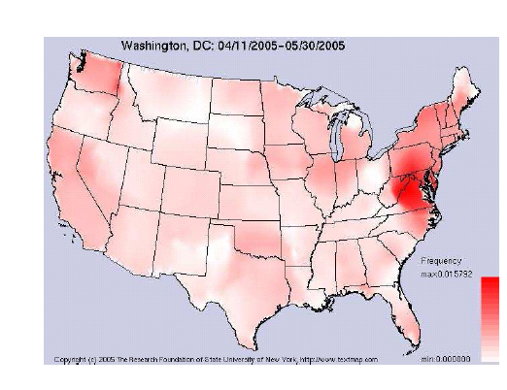
Cont.

Slide 48
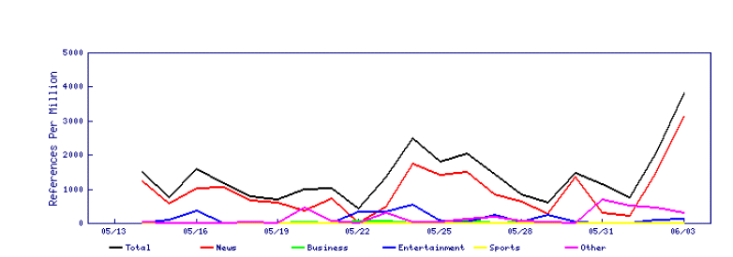
Temporal Analysis
Ability to track all references to entities broken down by article type gives the ability to monitor trends. Figure tracks the ebbs and flows in the interest in Michael Jackson as his trial progressed in May 2005.

Slide 49
How the paper is related to DM?
In the Lydia system in order to Classify the articles into different categories like news, sports etc., they use Bayesian classifier.
Bayesian classifier is classification and prediction algorithm.
Data Classification is DM technique which is done in two stages
-building a model using predetermined set of data classes.
-prediction of the input data.

Slide 50
Application
GIS (Geographical Information System)

Slide 51
What is GIS???
A GIS is a computer system capable of capturing, storing, analyzing, and displaying geographically referenced information;
Example: GIS might be used to find wetlands that need protection from pollution.

Slide 52
How does a GIS work?
GIS works by Relating information from different sources
The power of a GIS comes from the ability to relate different information
in a spatial context and to reach a conclusion about this relationship.
Most of the information we have about our world contains a location
reference, placing that information at some point on the globe.

Slide 53
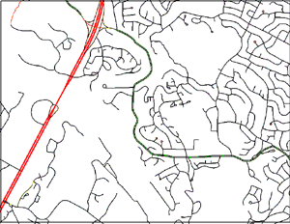
Geological Survey (USGS) Digital Line Graph (DLG) of roads.

Slide 54
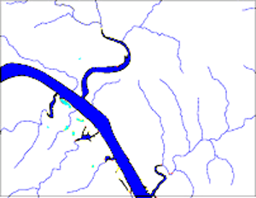
Digital Line Graph of rivers.

Slide 55
Data capture
If the data to be used are not already in digital form
- Maps can be digitized by hand-tracing with a computer mouse
- Electronic scanners can also be used
Co-ordinates for the maps can be collected using Global Positioning System (GPS) receivers
Putting the information into the system—involves identifying the objects on the map, their absolute location on the Earth's surface, and their spatial relationships .

Slide 56
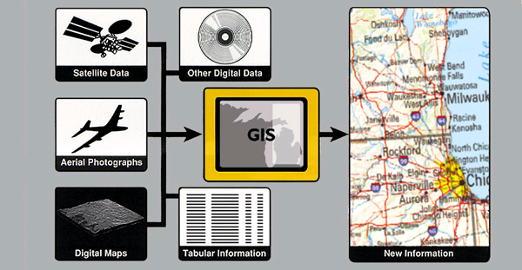
Data integration
A GIS makes it possible to link, or integrate, information that is difficult to associate through any other means.
Mapmaking

Slide 57
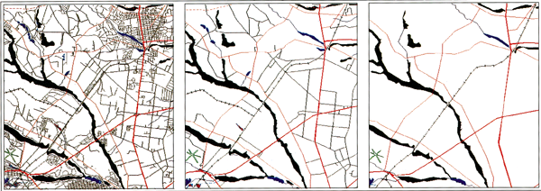
Mapmaking
Researchers are working to incorporate the mapmaking processes of traditional cartographers into GIS technology for the automated production of maps.

Slide 58
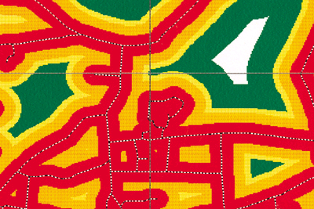
What is special about GIS??
Information retrieval: What do you know about the swampy area at the end of your street? With a GIS you can "point" at a location, object, or area on the screen and retrieve recorded information about it from off-screen files . Using scanned aerial photographs as a visual guide, you can ask a GIS about the geology or hydrology of the area or even about how close a swamp is to the end of a street. This type of analysis allows you to draw conclusions about the swamp's environmental sensitivity.

Slide 59
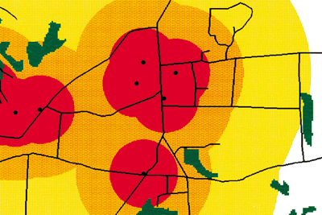
Cont.
Topological modeling: Have there ever been gas stations or factories that operated next to the swamp? Were any of these uphill from and within 2 miles of the swamp? A GIS can recognize and analyze the spatial relationships among mapped phenomena. Conditions of adjacency (what is next to what), containment (what is enclosed by what), and proximity (how close something is to something else) can be determined with a GIS

Slide 60
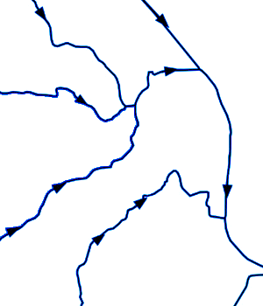
Cont.
Networks: When nutrients from farmland are running off into streams, it is important to know in which direction the streams flow and which streams empty into other streams. This is done by using a linear network. It allows the computer to determine how the nutrients are transported downstream. Additional information on water volume and speed throughout the spatial network can help the GIS determine how long it will take the nutrients to travel downstream

Slide 61
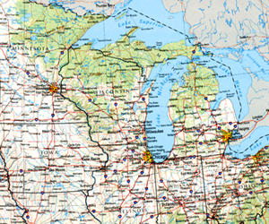
Data Output
A critical component of a GIS is its ability to produce graphics on the screen or on paper to convey the results of analyses to the people who make decisions about resources.

Slide 62
The future of GIS
GIS and related technology will help analyze large datasets, allowing a better understanding of terrestrial processes and human activities to improve economic vitality and environmental quality

Slide 63
How is it related to DM?
In order to represent the data in graphical Format which is most
likely represented as a graph cluster analysis is done on the data
set.
Clustering is a data mining concept which is a process of grouping together the data into clusters or classes.

Slide 64

?

